Slide 1

Building a responsive smart home: programming a Pepper robot
Priscilla Eniola Fatokun

Slide 2
Content
Introduction
What is a smart home
Benefits of as smart home
Setting up a smart home
What is a Pepper Robot
Conclusion
References

Slide 3
INTRODUCTION
The concept of smart home has gained significant popularity in the recent past. It enables the automatic control of household appliances scheduling, leading to the improved energy usage efficiency and reduced economical cost. Under the popular advanced metering infrastructure (AMI), the smart meter at a home system automatically receives the periodically updated utility pricing information sent from utility. Subsequently, the smart controller which implements the smart home scheduling algorithms will be activated to automatically schedule various home appliances with the target of reducing electricity bill, that is, shifting the heavy energy load off the peak pricing hours.

Slide 4

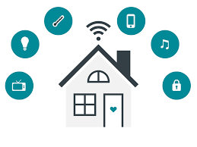
WHAT IS A SMART HOME

Slide 5
A smart home refers to a convenient home setup where appliances and devices can be automatically controlled remotely from anywhere with an internet connection using a mobile or other networked device. Devices in a smart home are interconnected through the internet, allowing the user to control functions such as security access to the home, temperature, lighting, and a home theater remotely.
A smart home’s devices relate to each other and can be accessed through one central point—a smartphone, tablet, laptop, or game console. Door locks, televisions, thermostats, home monitors, cameras, lights, and even appliances such as the refrigerator can be controlled through one home automation system. The system is installed on a mobile or other networked device, and the user can create time schedules for certain changes to take effect.

Slide 6
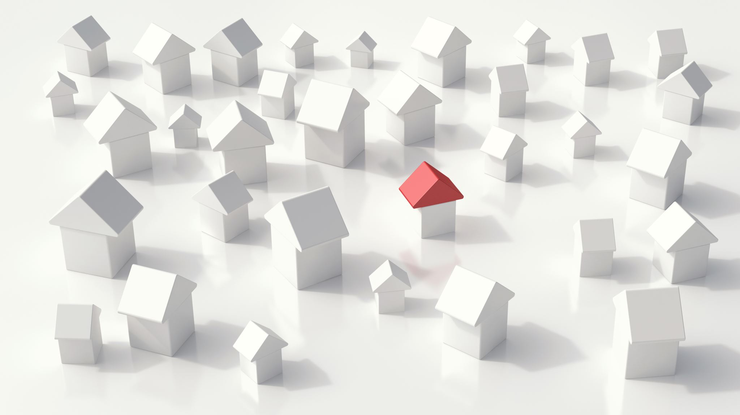
Features of a SMART HOME

Slide 7
A smart home allows homeowners to control appliances, thermostats, lights, and other devices remotely using a smartphone or tablet through an internet connection.
Smart homes can be set up through wireless or hardwired systems.
Smart home technology provides homeowners with convenience and cost savings.
Security risks and bugs continue to plague makers and users of smart home technology.
Though full-scale home automation may cost thousands of dollars, smaller individual products costing less than $100 can get homeowners started on smart home products.

Slide 8
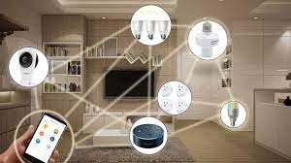
HOW TO CREATE A SMART HOME

Slide 9
First choose a voice assistant. Virtual voice-controlled assistants like Apple’s Siri, Google’s Assistant and Amazon’s Alexa make it easy to control smart home products by speaking simple commands like “Hey Siri, turn on off the lights.” Each of these tools has its pros and cons, so choose the one that will be more likely to work for your needs. Additions that make your house a smart home include:
Smart Thermostat: A smart thermostat is a Wi-Fi enabled device that automatically adjusts heating and cooling temperature settings in your home for optimal performance. A smart thermostat is a thermostat that can be controlled with a phone, tablet, smart speaker, or other internet-connected device. Smart thermostats typically allow you to schedule your desired temperature settings, and you can also incorporate them into home automation systems.
Smart Lighting: Smart lighting is when your lights are controllable remotely using a wireless connection and a smartphone app. You can set timers for your lights and create schedules or routines to turn them on and off at a set time or based on specific actions. You can sync your lights with sunrise and sunset, dim or change their color, control groups of lights on more than one circuit simultaneously, and have lights turn on and off automatically based on motion and / or occupancy.

Slide 10
Home Security Cameras & Video doorbells: A quality home security camera will enable you to keep a watchful eye on your home, especially while you’re away. Indoor models can help you monitor your children and pets, while outdoor models can catch prowlers in the act—and hopefully discourage them from coming around in the first place. Cameras incorporated into doorbells can monitor your porch and let you interact with visitors without needing to approach the door—or even be home at the time. The best models can discern between people and pets and recognize the presence of a package left at your door.
Smart Refrigerator: Smart refrigerators feature a touchscreen interface and the ability to connect to the internet through Wi-Fi to provide several additional features. Smart refrigerators include internal cameras, more flexible user-controlled cooling options, and the ability for you to interact with its features using your smartphone or tablet when away from home. Some smart refrigerators can even connect with other smart devices in your home; such as speakers, smart TVs, and even your smart dishwasher or smart microwave.

Slide 11
Smoke Detection and Alerts: Timely smoke and fire detection can make a significant difference in your safety. The system will automatically alert you and deploy sprinklers in case of fire to reduce spread.
Automatic Irrigation: To keep the garden and lawns in top shape without relying on the hose, smart sprinklers are a convenient solution. Once the irrigation system is installed, it can be switched on and controlled from anywhere with Wi-Fi. Features can even include scheduling and synchronization with weather apps to prevent overwatering when rain is sufficient.

Slide 12
PROS OF A SMART HOME
Increase in convenience: Smart home devices simplify everyday tasks allowing you to relax when you’re at home as well as when you’re away from it. Many technological appliances include remote capabilities, so you can adjust things even if you’re physically outside of the home. No more worrying if you left too many lights on — now you can use your smartphone to turn everything off without needing to head home to check
Higher quality of life:
Energy Efficiency: Energy management devices like lighting controls, smart power strips, and smart plugs can all help to reduce both your impact on the environment, and your monthly utility bill.
Accessibility for all ages: smart home technology is the increase in accessibility around the house. Aging individuals or those with physical disabilities can now more easily access their home, offering complete control right at their fingertips.

Slide 13
Cost saving in the long run: Since you can save large amounts of energy using smart home technologies, you can also save plenty of money in the long run.
Suitable for people with disabilities: since a lot of smart home devices are voice controlled it relieves people from having to move around a lot.

Slide 14
CONS OF A SMART HOME
Significant installation cost: Smart homes can be quite costly. There might be significant installation costs which may amount to many thousands of dollars.
Reliable internet connection is crucial: smart homes require a reliable internet connection. For instance, if you live in an area where the internet connection is rather poor, you might experience serious issues since your smart home devices might not respond the way you want them to.
Security issues: There might also be some security issues associated with smart home technologies. For example, burglars could hack into your smart home system and open the lock in order to get access to your home.
Helplessness if technology fails: Since you always relied on this technology to work and adapted your behavior, you might feel lost in case your smart home technology will not work anymore. Excessive reliance on those technologies might not be a good thing

Slide 15
Vulnerabilities: While we now have access to these awesome, interconnected devices that make our lives so much easier both at home and at work, they also make us more vulnerable to potential cybersecurity breaches. It’s important to remember that hackers can take control of your connected devices at any time.
Maintenance and repair issues: Many handymen are not skilled enough in this field yet and finding an export to fix those smart home technologies might not be easy.
Some initial learning efforts necessary
Surges are possible: Due to the interconnectedness of those household devices, also the probability of surges increases. If your home is not protected properly, this may increase the chance for fires and in the worst case, your house may burn down due to the use of too many smart household devices at the same time.

Slide 16
Effects of smart homes on HealthCare
Instead of hospitalization or institutionalization, the elderly and disabled can be assisted in their own environment 24h a day with numerous 'smart' devices. smart home is a promising and cost-effective way of improving home care for the elderly and the disabled in a non-obtrusive way, allowing greater independence, maintaining good health, and preventing social isolation. Smart homes are equipped with sensors, actuators, and/or biomedical monitors. The devices operate in a network connected to a remote center for data collection and processing. The remote center diagnoses the ongoing situation and initiates assistance procedures as required.

Slide 17

PEPPER ROBOT

Slide 18
Pepper is a friendly humanoid designed to be a companion in the home and help customers at retail stores. It talks, gesticulates, and seems determined to make everyone smile. Pepper is the world’s first social humanoid robot able to recognize faces and basic human emotions. Pepper was optimized for human interaction and can engage with people through conversation and his touch screen. Pepper is a 121cm tall humanoid robot who was born on June 5th, 2014. As Pepper is designed for human interaction with vocal conversation as well as through his table, Pepper has been actively working in various fields such as in homes, shopping malls, schools, offices, senior residential homes, and so on! Pepper is continuously evolving based on your requests and the world surrounds him.

Slide 19
FEATURES OF PEPPER

Slide 20
FEATURES OF PEPPER
Advanced language recognition skills: The four directional microphones located on Pepper's head allow it to detect where sounds are coming from and locate your position, as well as identifying the emotions in your voice. Pepper can engage in conversations and can incorporate information it has gleaned from the conversation into what it says.
Facial recognition: The images it sees are processed by shape recognition software that can identify faces and objects. It can detect movements, as well as recognizing emotions on your face.
Object recognition: It can be taught to recognize objects and can then pick them out in a room.
Pepper has a voice that can be tailored and express emotion with variable pitch
Collision-avoidance sensors: Pepper has many sensors including two ultrasound transmitters and receivers, six laser sensors and three obstacle detectors placed in his legs. These sensors provide it with information about the distance of nearby objects (up to a range of 3 meters) and help to reduce the risk of unexpected collisions.

Slide 21
Sensors on arms, chest and head: Pepper has tactile sensors in its hands, which are used when it is playing games or for social interaction, as well as in hits head.
Flexible programming interface with unlimited applications
Stable body with wheelbase: The wheelbase is efficient and makes Pepper more stable than robots with legs. Pepper is also able to maintain its balance, with mechanisms that help prevent it from falling if somebody knocks into it.

Slide 22
CLAFLIN’S SMART HOME
Claflin university is building a smart home that consists of all and more of the devices listed above. This smart home is controlled by a google assistant.

Slide 23
PROJECT GOAL

Slide 24
For my thesis project, I am working on programming the Pepper robot at the Claflin University Smart home. Because this smart home is mainly for touring, my goal is to make Pepper a tour guide. To do this, I have installed a software called Choregraphe. On this platform I can program Pepper to greet, ask introduction questions, lead tourist through the house, answer questions and many more things. Pepper will describe all the devices in the home and give the tourists time to experience this devices.

Slide 25
CONCLUSION

Slide 26
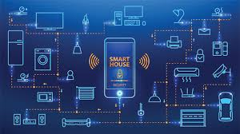
A truly smart home is one that elevates everyday living through a unified home automation system. From security and cooking to entertainment and grounds management, the flawless integration of smart technology can transform an already superb home into an exceptionally optimized property. This is our goal for the Claflin University Smart Home.

Slide 27
REFERENCES
Andreas. “30 Key Pros & Cons of Smart Homes.” E&C, 1 Dec. 2021, https://environmental-conscience.com/smart-homes-pros-cons/.
Gwsadmin. “Pepper Robot Features - Why Pepper?” GWS Robotics, 14 Feb. 2017, https://www.gwsrobotics.com/why-pepper-robot.
Hayes, Adam. “Smart Home: Definition, How They Work, Pros and Cons.” Investopedia, Investopedia, 21 Sept. 2022, https://www.investopedia.com/terms/s/smart-home.asp.
Null, Christopher, and Freelance Contributor. “Smart Home for Beginners: How To Lay a Foundation You Can Build On.” TechHive, 3 Feb. 2022, https://www.techhive.com/article/583408/smart-home-guide-for-beginners-how-to-make-your-home-more-convenient-to-live-in.html.
“Smart Home System.” Smart Home System - an Overview | ScienceDirect Topics, https://www.sciencedirect.com/topics/computer-science/smart-home-system.

Slide 28
THANK YOU

